Slide 1
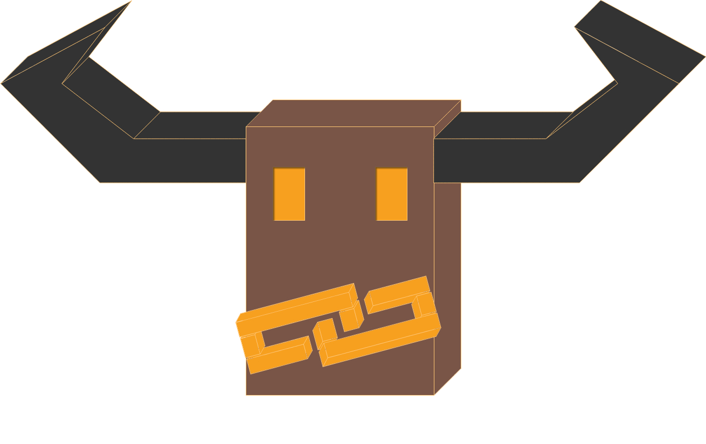

Chainge An Incentive System to Save the Planet Nico Hauser, David Rode, David Schmid, Ben Spöttling, Patrick Züst … WWF “Wild AI” Challenge

Slide 2
Chainge is a decentral platform for environmental campaigns. It offers transparency to donors and short-term rewards to citizens. The platform is heavily based on the model presented by WWF representatives during BETH 2019. Each campaign is split into three stages:
Donations
The parameters of a campaign are saved in a blockchain and displayed online. Donors can send Ether to support the campaign.
They have full transparency of where their money goes and how it is used.
A campaign includes among other things a predefined impact goal, a number that indicates, how the funds are split (ratio initiator / community), and the duration of each campaign stage.
Campaign
When the campaign starts, a defined share of the total funds goes to the campaign initiator.
It is possible to define actions that can be fulfilled by local citizens. They are rewarded with both Ether and a special voting token, if the completion could be verified. The amount depends on the complexity of an action. Sensors constantly monitor different environmental factors and store the data in a blockchain.
Voting
If the impact goals were not met (automatically calculated using the sensor data), the remaining funds go back to the donors. Otherwise, citizens can use their tokens to vote on different community projects and thus determine the distribution of the remaining Ether.
The local community is thus incentivized to make the campaign successful and even participate as data gatherers. They can benefit individually, but also collectively.

Slide 3
The new funding model…
The blockchain…
…incentives local citizens to participate in environmental campaigns. A short-term reward for them means a long-term reward for the planet.
…not only supports wildlife, but also communal projects.
…allows investors to make impactful donations and get money back, if the campaign was not successful.
…makes environmental campaigns without middlemen possible. Many people mistrust non-profits and they are more likely to donate, if they can verify, where their money goes.
…guarantees citizens that they will be rewarded for their actions and for a successful campaign. Neither donors nor initiators can stop the contract or manipulate the data; both is stored in the blockchain.
This will lead to…
…more donations, higher environmental impact, less fraud, engaged citizens and a healthier planet.

Slide 4
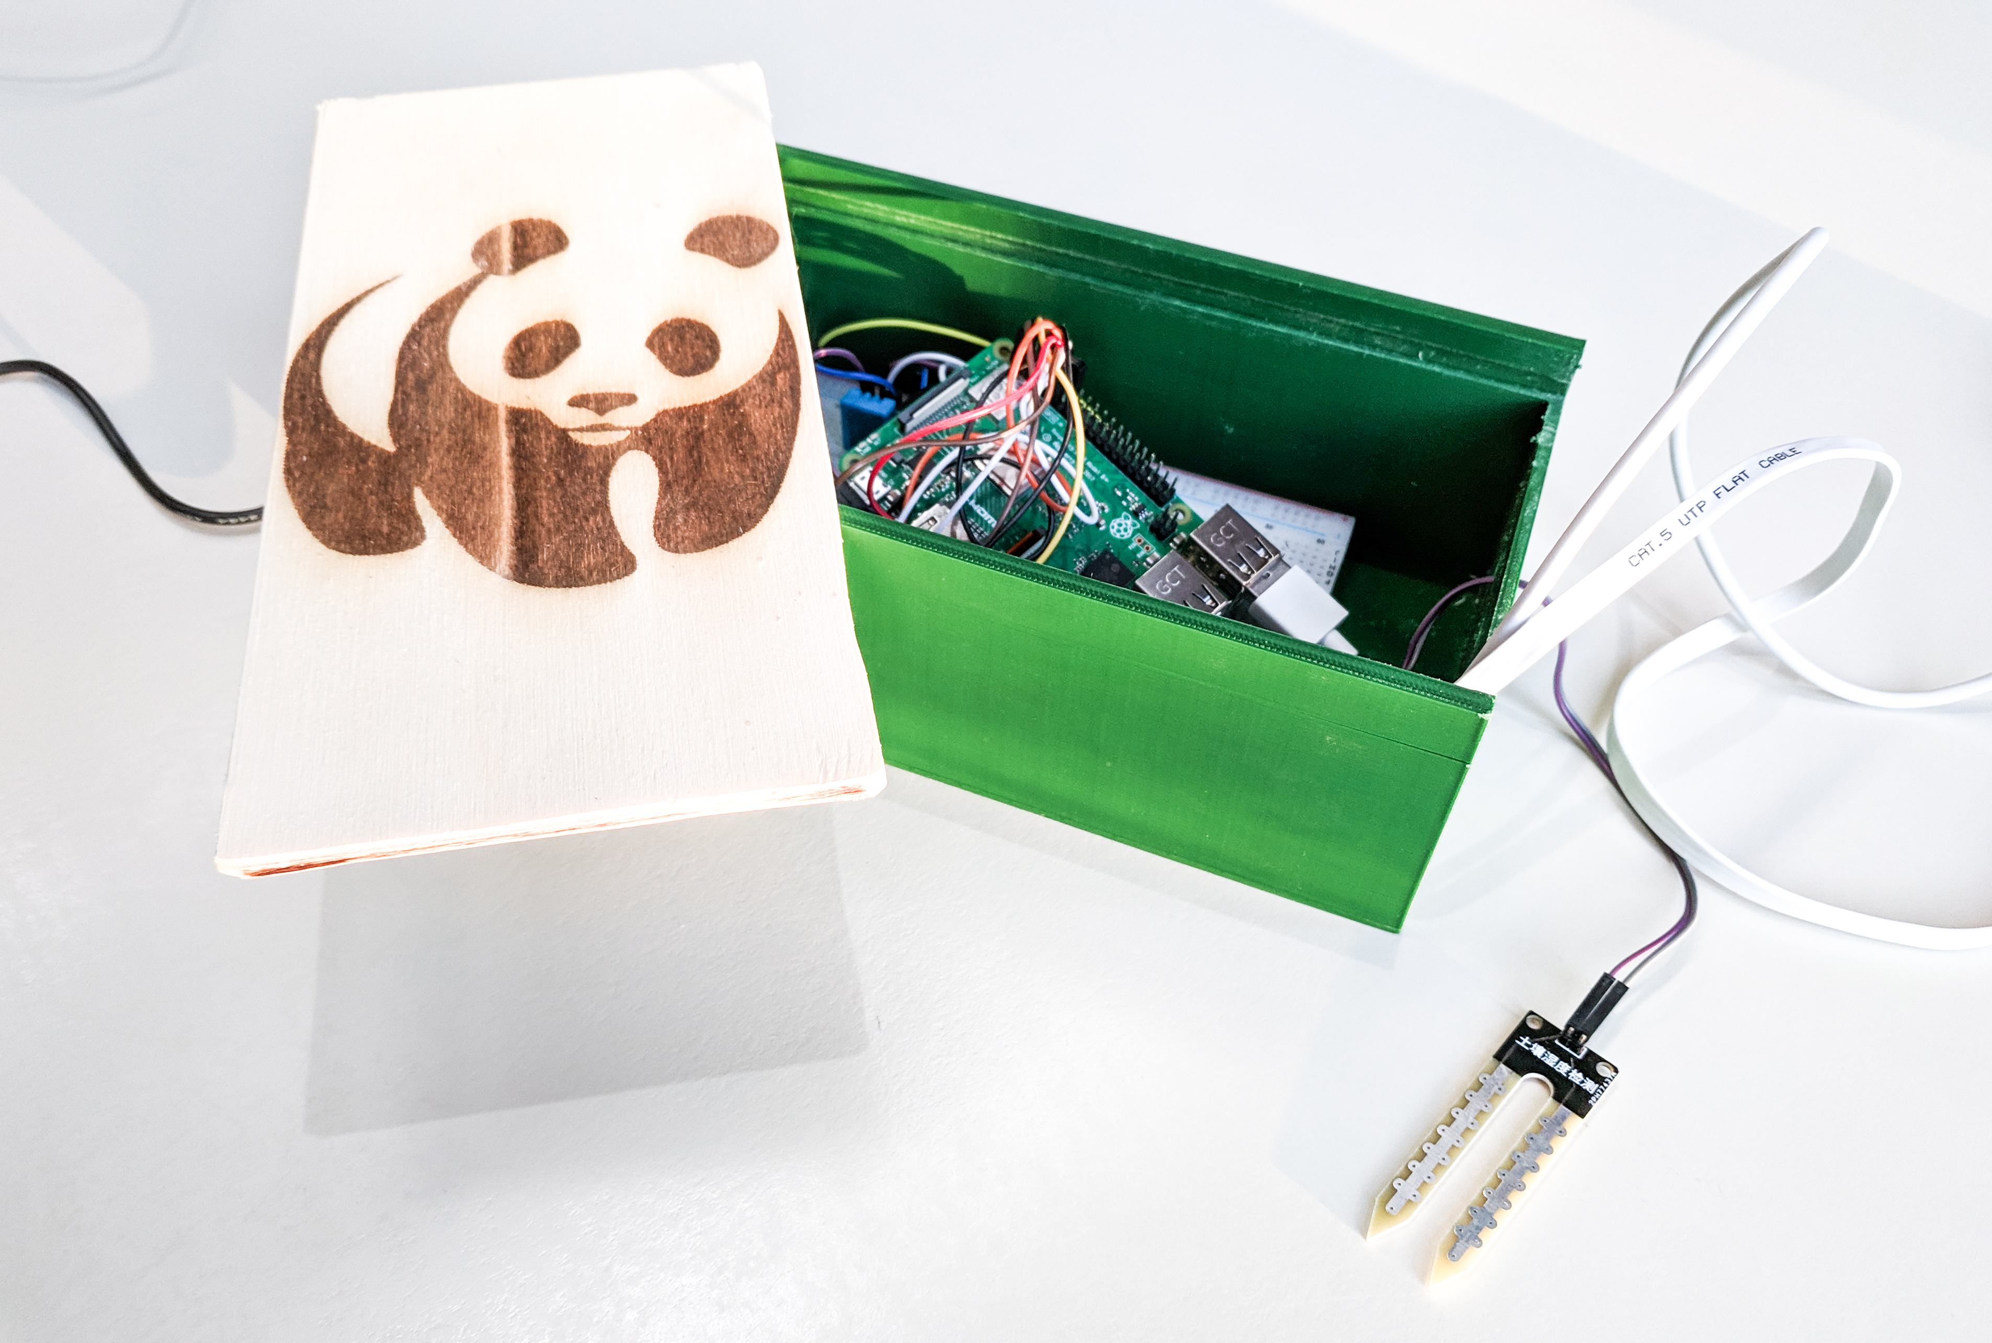
This works:
We have to keep working on this:
Responsive frontend that successfully interacts with the blockchain using web3.js.
Donations are stored and properly managed in a smart contract. The payout to donors (i.e. community projects) is proportional to the amount of money (i.e. voting tokens) that was invested.
Citizens are reimbursed for their actions with voting tokens, which can then be used in the voting phase.
Working physical prototype of a sensor module that can process data of several sen- sors and then store it in a blockchain.
Make sensor module more reliable
Rewrite smart contract to ensure that it is 100% secure and can not be exploited
Verification of actions and uploaded data
Work with actual data and actual impact goals
That’s what we are thinking about:
Who should be allowed to suggest new community projects? How can we ensure that they are legit?
Should we let donors decide, what ratio of their money should go towards community projects?
How can we verify, whether an action was fulfilled? Can we do it in a decentralized way? Maybe with a reputation system?
What would be a better way to store all that data?
How could we deploy this to the real world?

Slide 5
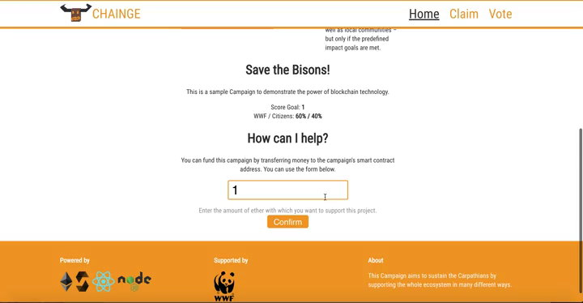
Demo

